Slide 1
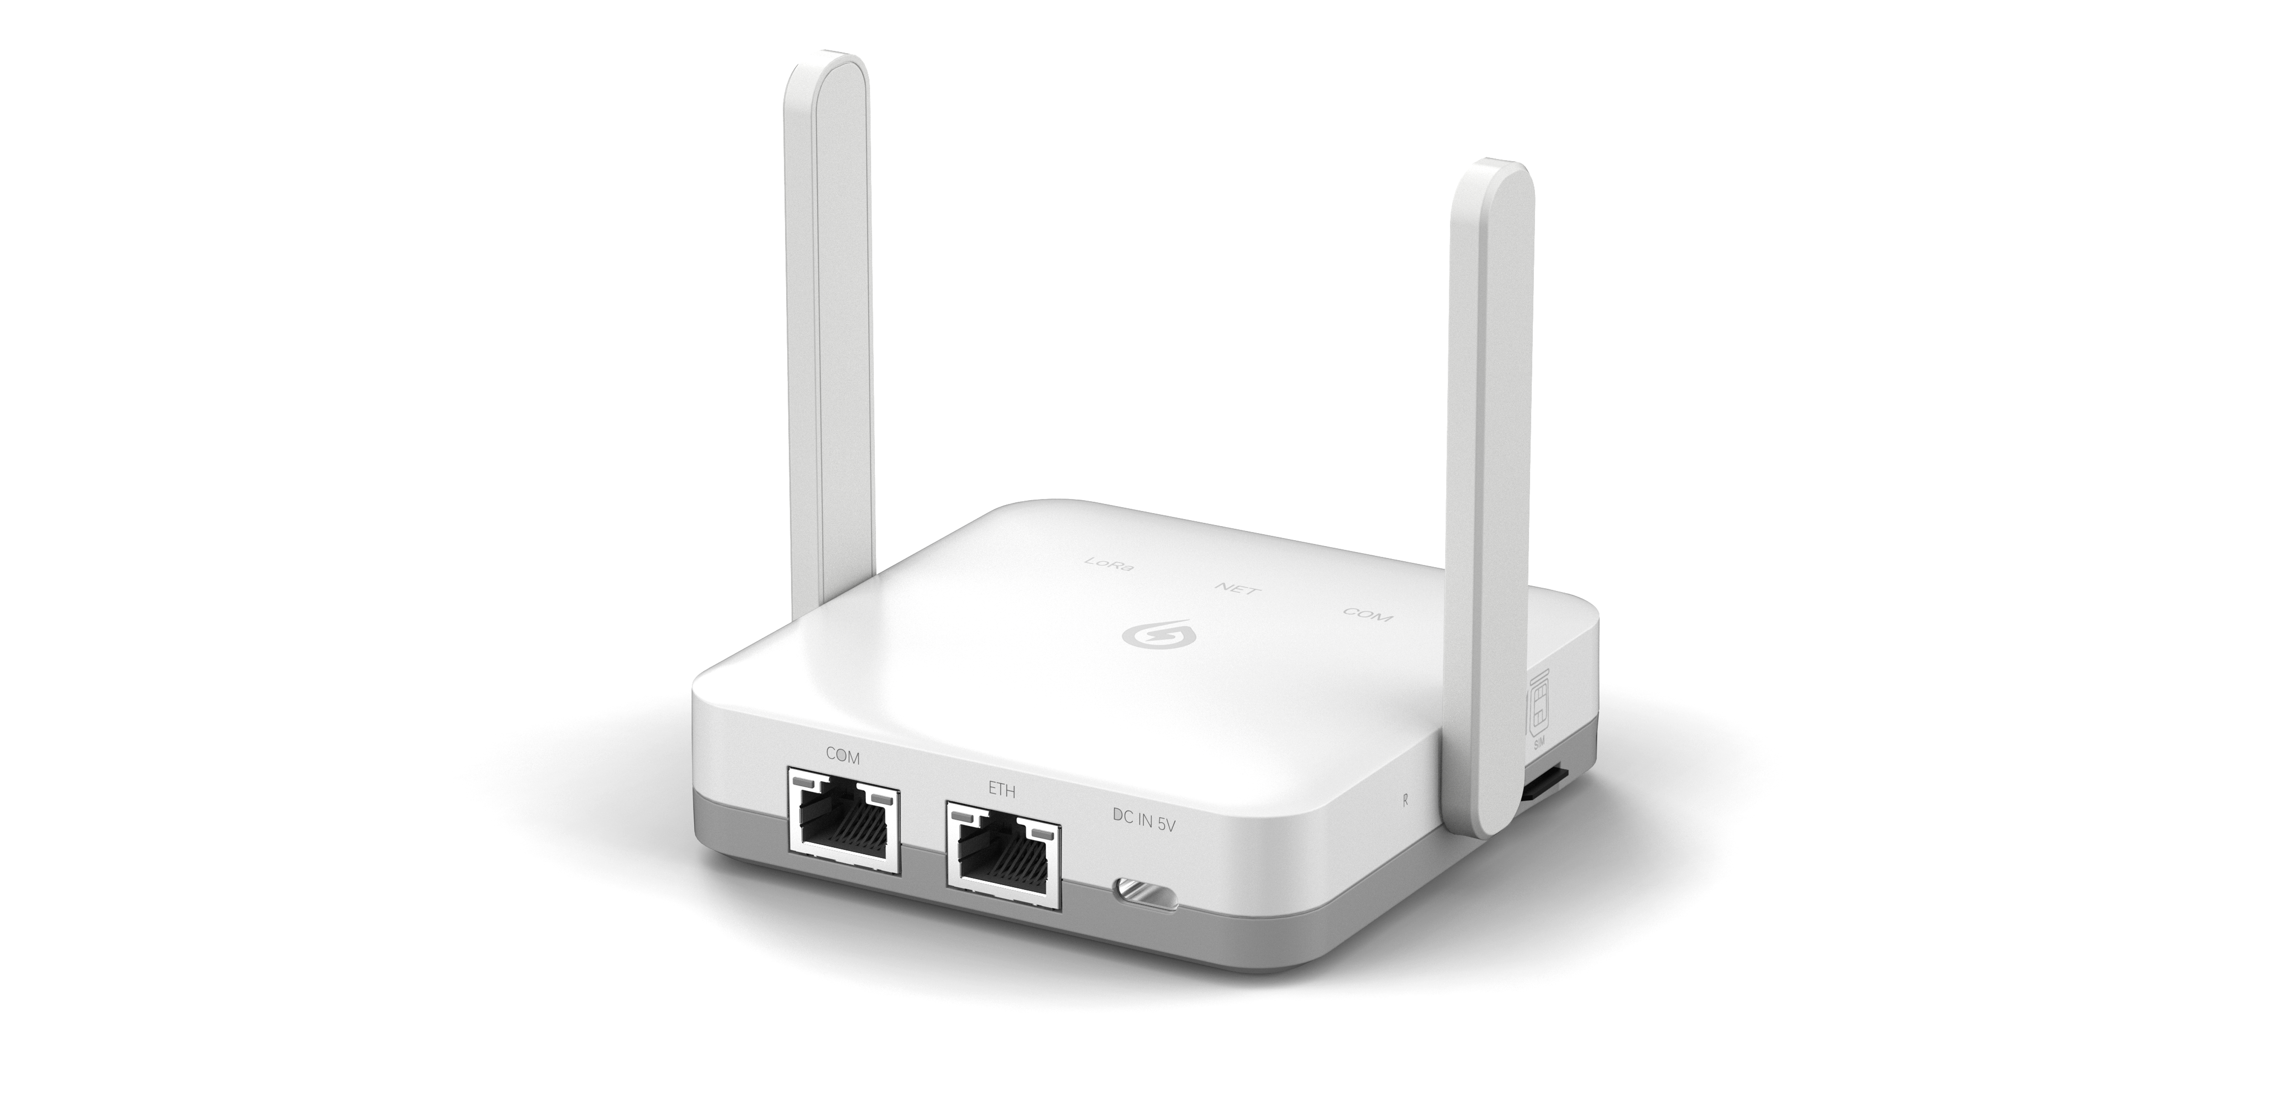
EMH-2M-RG
Smart Gateway
Smart Gateway
EMH-2M-RG is specially designed for residential, small-sized C&I scenario with multiple device access. It supports diverse device types, such as module PV optimizers, inverters, batteries, meters, and etc.. Meanwhile, it supports data transmission via Ethernet and WiFi. This helps users improve the efficiency of remote monitoring and management, facilitating multiple functionalities such as data collection and reporting, configuration deployment, firmware upgrade, and real-time control.
Applicable Scenarios
Suitable for residential, small-sized C&I scenario with multiple device access Real-time monitoring and management of new energy equipment Remote upgrade of equipment Analyze and optimize the consumption and power generation data to achieve refined operation and maintenance(O&M) Centralize the management of multiple equipments to realize quick fault location and reduce O&M losses.
Features
Supports Bluetooth network distribution, with a fast and high success rate
Built-in edge-side twin model for fast customization and adaptation
Supports access to inverters, batteries, meters, optimizers and other new energy devices.
Support Ethernet, WiFi and other communication methods to upload data to the cloud platform.
Extends the monitoring range of devices through LoRa to ensure the stability and reliability of data transmission.
Complies with EN 18031 IoT network security standard

Slide 2
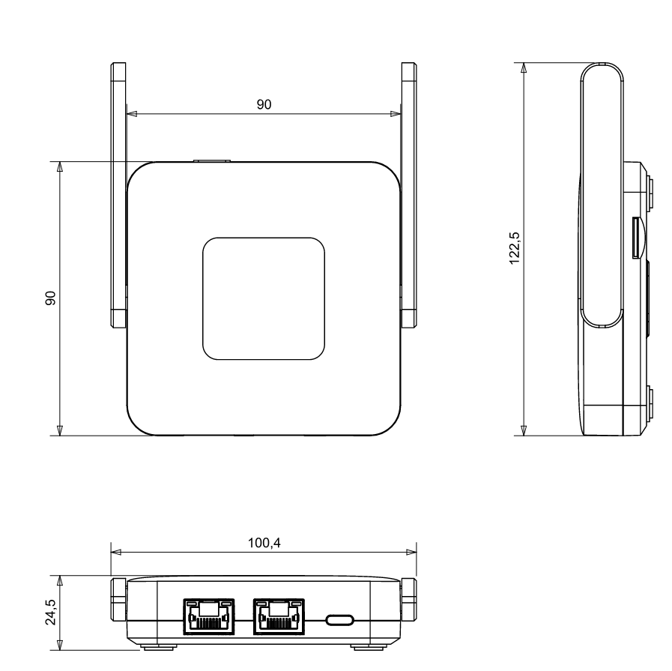

Technical Specifications
Communication Parameters
LoRa Operating Frequency | 868MHz
Ethernet | 1 channel 10/100M adaptative
WiFi Specification | WiFi 6（IEEE802.11b/g/n/ax）
WiFi Operationg Frequency | 2400 ~ 2483.5MHz
BLE Standard | BLE 5.3
BLE Operating Frequency | 2400 ~ 2483.5MHz
4G Operating Frequency | China/India: LTE-FDD:B1/3/5/8; LTE-TDD:B34/38/39/40/41 GSM:B3/8; Brazil/Australia/New Zealand: LTE-FDD:B1/3/5/7/8/20/28; GSM:B2/3/5/8; Latin America: LTE-FDD:B2/3/4/5/7/8/28/66; GSM:B2/3/5/8;
Antenna Type | External/internal antenna
Unit ：mm
Hardware Parameters
Size ( L×W ×H ) | 122.5mm×90mm×24.5mm
Installation | Wall Mounted/Flat
Operating Voltage | DC 5V±5%
Operating Power | ＜4W
External Interface | RJ45 Ethernet port, RJ45 port (no light) with RS485 interface, TypeC power input port
Input Power | 5V 2A
Reset Button | × 1
Indicator Light | LoRa status indicator light Server connection status indicator light Serial port connection indicator light
Data Storage | Default configuration 8MB
Operating Temperature | -20℃~+50℃
Operating Humidity | 10%-70% RH no condensation
Storage Temperature | -40℃~+90℃
Storage Humidity | <40% RH no condensation
Software Parameters
Access Number via RS485/Ethernet | ≤10 Units
Lora AccessNumber | Default:1 (1-10 configurable)
Serial Port Communication Rate | Default: 9600bps (1200-115200bps configurable)
Data Upload Frequency | Default: 5 minutes
User Configuration | Remote configuration
Firmware Upgrade | Remote upgrade
Reboot Mechanism | Software and hardware watchdog timer
Breakpoint Resuming | Supported
版本A3
Version A0
www.solarmanpv.com | info@solarmanpv.com | +86 153-1222-5591

